Slide 1
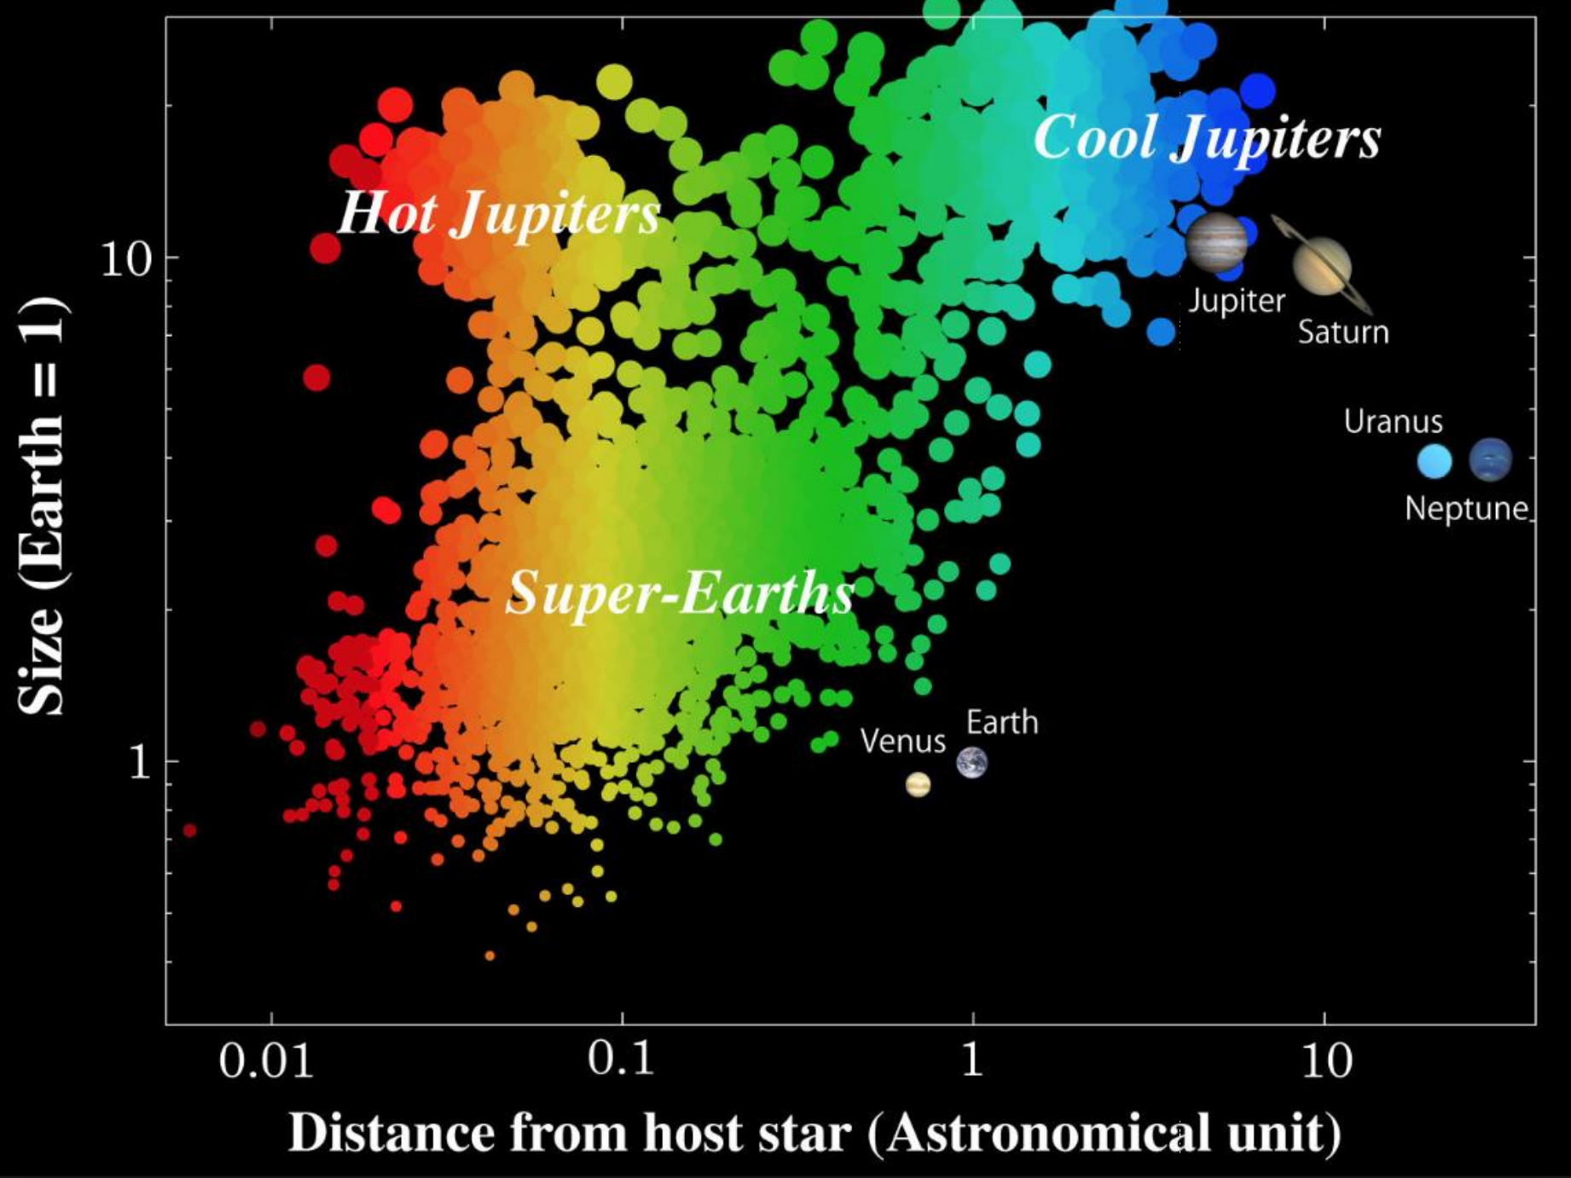
Why is our Solar System so different?
Exoplanetary systems:
Hot-Jupiters close to stars
Super-Earths very common
Our Solar System:
No hot-Jupiter
Giant planets are far from the Sun
Is our Solar System typical—or unusual?

Slide 2
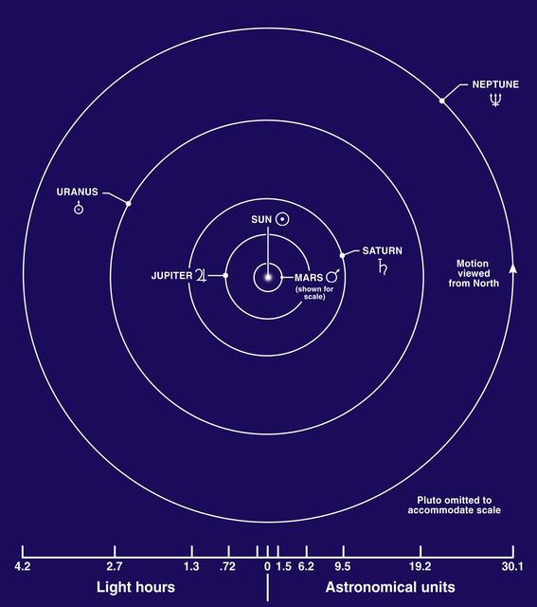
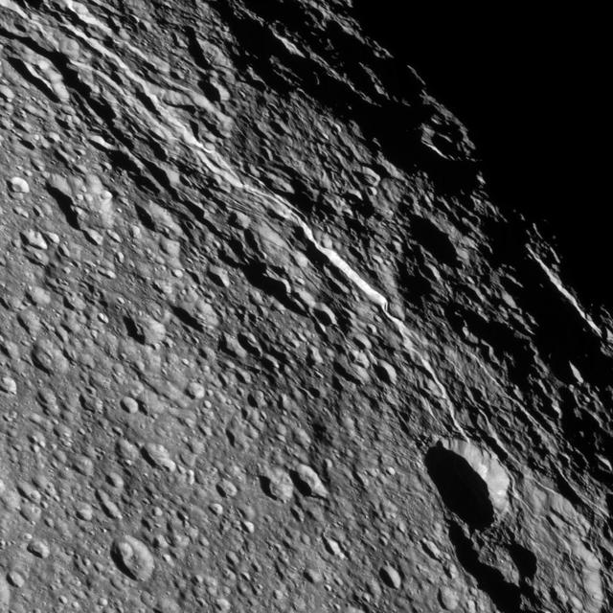
Key Puzzles in the Solar System
Giant planet orbits:
Large spacing
Non-zero eccentricities and inclinations
Difficult to explain with a static formation model
Kuiper Belt:
Structured distribution
Evidence of past perturbations
Late Heavy Bombardment (~3.8 Ga):
Sudden spike in impact events
Recorded in lunar samples

Slide 3
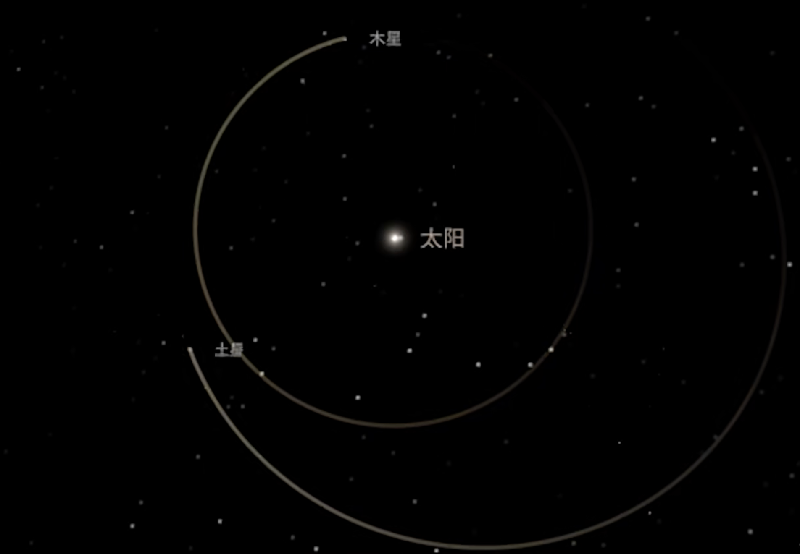
Two key papers
1."Origin of the cataclysmic Late Heavy Bombardment period of the terrestrial planets." Nature, 435, 466-469 (2005).
Method:
N-body simulations (giant planets + outer disk)
Process:
Planet–disk interaction → migration
Jupiter moves inward
Saturn moves outward
Key mechanism:
Jupiter–Saturn enter mean-motion resonance
→ Orbital eccentricities increase
→ Dynamical instability triggered
Result:
Planetesimals scattered inward
→ Explains Late Heavy Bombardment

Slide 4
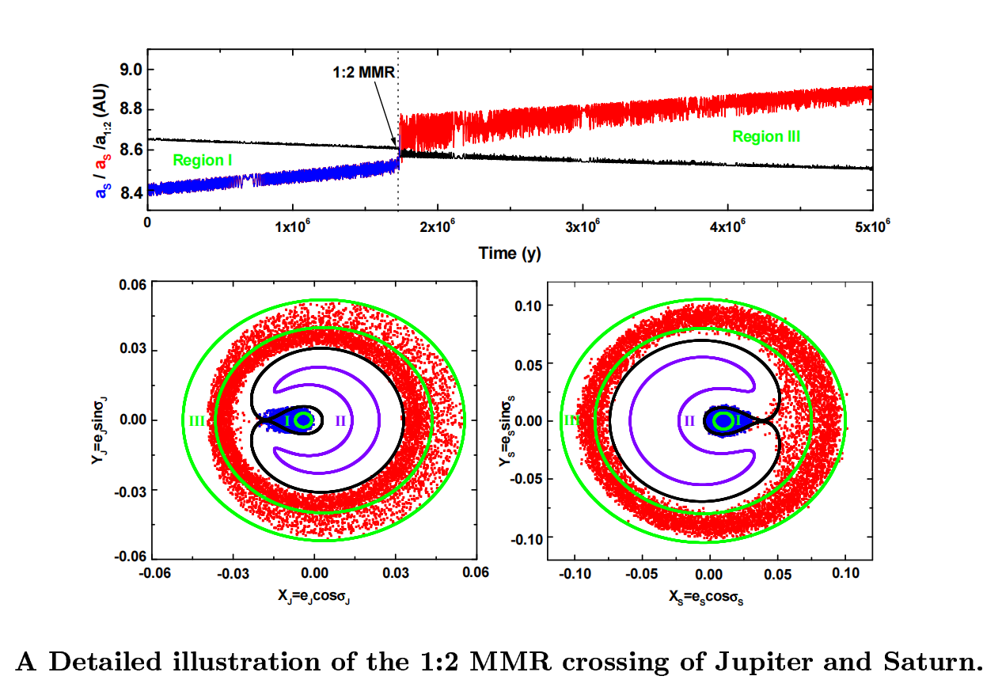

Slide 5
Two key papers
2."Origin of the orbital architecture of the giant planets of the Solar System." Nature, 435, 459-461 (2005).
Method:
N-body simulations from compact initial system
Process:
Instability phase → close encounters
Angular momentum exchange
Key outcome:
Large-scale planetary migration
Result:
Final orbits match present Solar System
Explains spacing, eccentricity, inclination

Slide 6
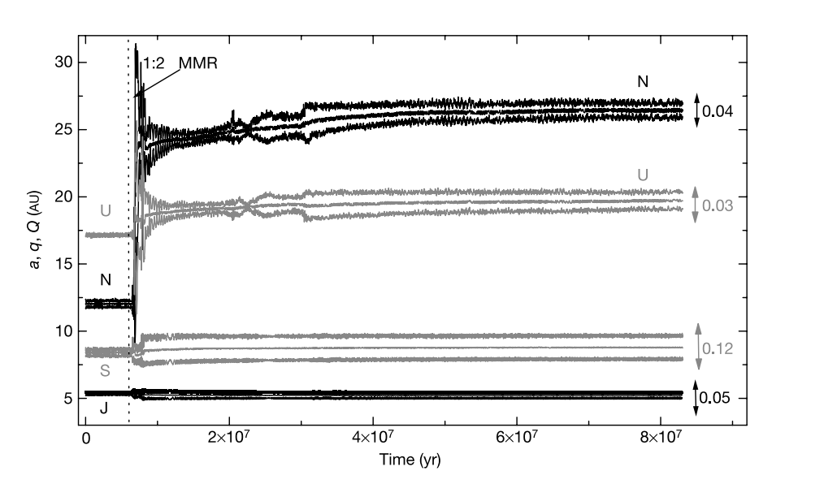


Slide 7
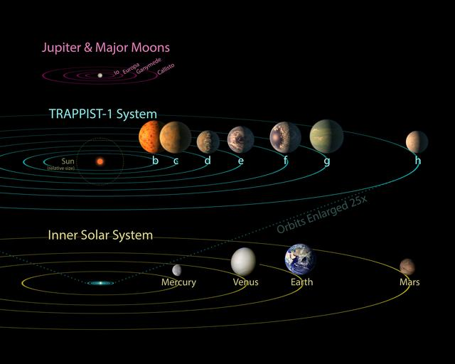
The Nice Model
Migration → Resonance → Instability
One mechanism explains multiple observations
Giant planet migration
Late Heavy Bombardment
Implications:
Solar System is dynamically evolved
Planetary migration

